Slide 1
Esfp-2 project
CLOTHING MANAGEMENT SYSTEM

Slide 2
DETAILS OF GROUP MEMBERS
NAME : KRUTIK SHAH
ENROLLMENT NUMBER:18162121035
NAME:SMIT SHAH
ENROLLMENT NUMBER:18162121036
NAME:SALONI SINGH
ENROLLMENT NUMBER:18162121037

Slide 3
Project is divided into 3 parts: 1)group member1 2)group member 2 3)group member 3
s

Slide 4
Task of group member 1 is :
Display all the clothes whose cloth type is ‘cotton’
Display all the clothes whose cloth description contains ‘available in pieces’
Display all the clothes whose price is less than 500/-

Slide 5
Task of group member 2 is:
. Display all the clothes description whose sales tax percentage margin is between 10% to 25%.
Display all the details of the clothes whose cloth category is ‘trouser’.
Display all the clothes sorted according to gender type.

Slide 6
Task of group member 3:
Display all the clothes which belong to category shirts.
Display all the clothes whose cloth type is silk as well as cloth category is saree.

Slide 7
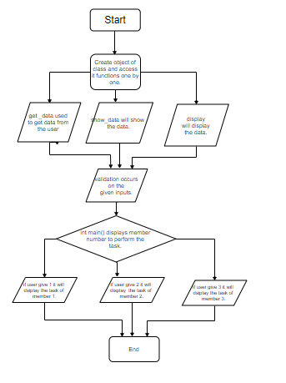
Flowchart

Slide 8
algorithm
Step1->Read the inputs from the users.
Step2->The information in validated at the time of the input.
Step3->Process the data according to the given conditions
Step4.->Create object of ofstream to write the output in the file.
Step5.->Access the object of class using function.
Step6->Exit the code to terminate the program.

Slide 9
Class name is cloth_mgmt
Data types are:
Int
Float
Char and
String

Slide 10
Library files included:
#include<iostream> for basic input and output services.
#include<fstream>for file handling.
#include<cstring>for string.

Slide 11
Functions:
We have created 3 functions :
void get_data()
void display()
void show_data()

Slide 12
Void get_data()
In void get_data () function we are printing those inputs which is specified in question and scanning those inputs. And we have created a else ..if loop in cloth gender type.

Slide 13
Void show_data()
Void show_data () function will show that inputs which we taken in get_data ().

Slide 14
Void display()
Void display() will display the data .
In void function we have created a else..if loop for member 1,2,and 3.

Slide 15
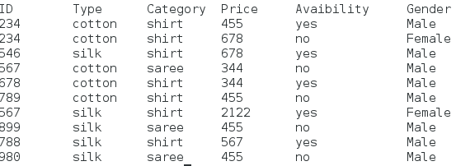
Member 1 task:
Display all the clothes whose cloth type is ‘cotton’
Display all the clothes whose cloth description contains ‘available in pieces’
Display all the clothes whose price is less than 500/-

Slide 16
Member 2 task:

Slide 17
Member 3 task
The task of member 3 is to print all cloth whose category is shirt and all cloth whose type is silk and category is saree.

Slide 18
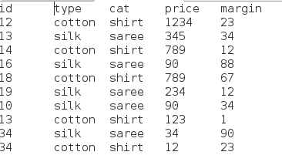
Exceptional handling in member 3 task:

